Slide 1

Selvaggia Salvati Videogame Producer, 3D Modeller and (soon) VR Artist LinkedIn > https://www.linkedin.com/in/ssalvati/ Github > https://github.com/Selvaggia-S/Puzzler
PUZZLER: MY FIRST VIRTUAL REALITY GAME
I am attending the “Virtual Reality Designer” nanodegree on the online platform Udacity and this is the first project I’ve completed for Android.
Puzzler is a game where the user should solve a simple puzzle in a spooky and dungeon-like building. The puzzle is similar to the game “Simon Says”: in order to win, the player should repeat the combinations exactly as shown by the floating eyeballs inside the dungeon.
DEVELOPMENT FOCUS
It was very important for me as developer to create a game that would be
An introduction to VR games for mobile phone users.
A user-friendly game with few and very simple rules.
A fun game, despite the eerie atmosphere.
PUZZLER
I started prototyping the game through sketches, defining the concept of how the dungeon should look like, what should be inside the building and how the outdoor area should appear.
As the final platform is Android, I took special care in optimizing the game so that it could run smoothly on mobile phones, without sacrificing the overall quality of the graphics.
During the creative process, the game went through several user testing to ensure a smooth playability and to improve its features.

Slide 2

Puzzler was tested by people with some experience in virtual reality as well as by users with almost no experience in playing videogames. Their constructive feedback helped to set the basis for an intuitive gameplay.
GAMEPLAY
Please watch the video below in presentation mode (and with a VR viewer for a better experience).
Problems is visualizing the video? Click here to watch it on YouTube.

Slide 3
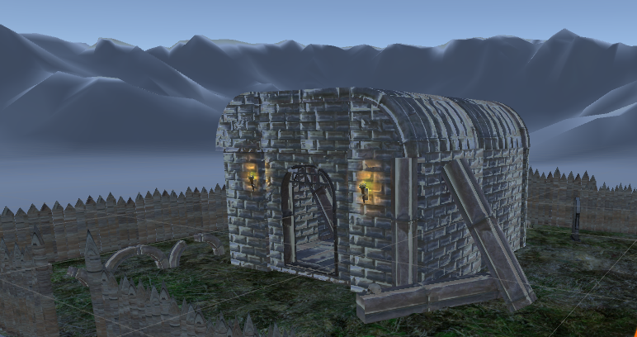
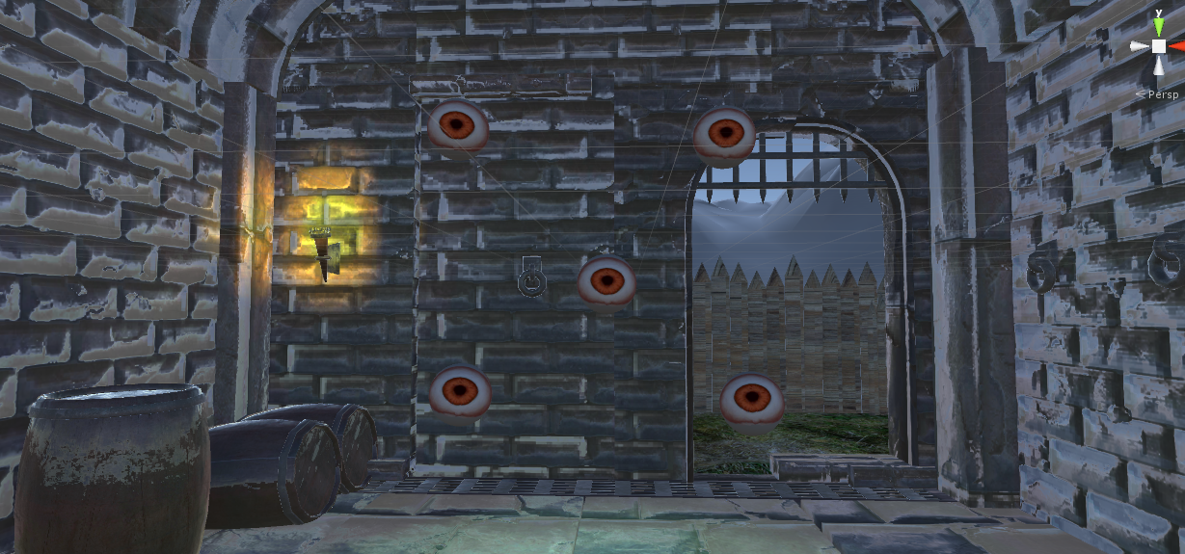
Find below screenshots of the VR experience.

Slide 4
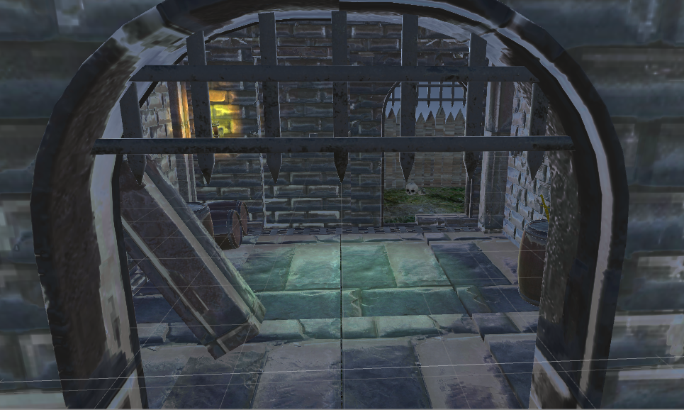
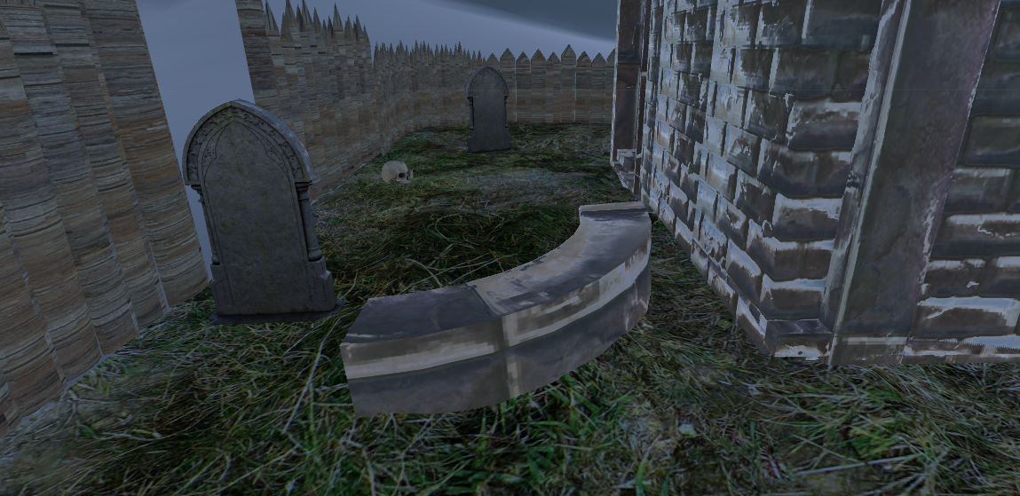

Slide 5
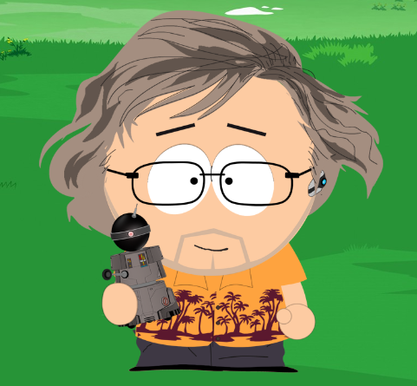
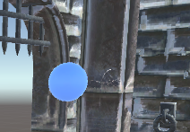
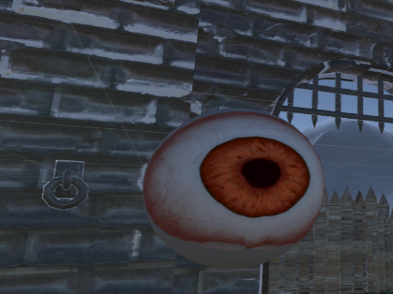
THE PROCESS
STATEMENT OF PURPOSE
“Puzzler" is a mobile application which introduces you to virtual reality. It helps to train your memory by showing easy combinations the end user should repeat in sequence.
PERSONA
For the project, I created a persona. His name is Leo, he’s 52 years old he’s working in the film
industry as aerial camera pilot . He is a technology enthusiast and recently his daughter
showed him 360° and VR videos on the mobile phone through Google Cardboard.
He would like to learn more about this new technology, but his free time is very limited.
Leo thinks: “When I retire, I’ll finally learn to program my own robot”.
SKETCHES
These are the early sketches I have done, in order to prototype the scene beforehand. This simple process helped me defining the layout before working in Unity.
I prepared as well sketches for the graphical interfaces, the panels at the start and at the end of the game.
The concept in paper was not very detailed at the beginning, but it was fundamental to set the mood and worked as general blueprint. This is true especially for the orbs, that will later evolve into floating eyeballs.
1st orbs concept
In 3D, following >>>>>>>> final result
sketch

Slide 6
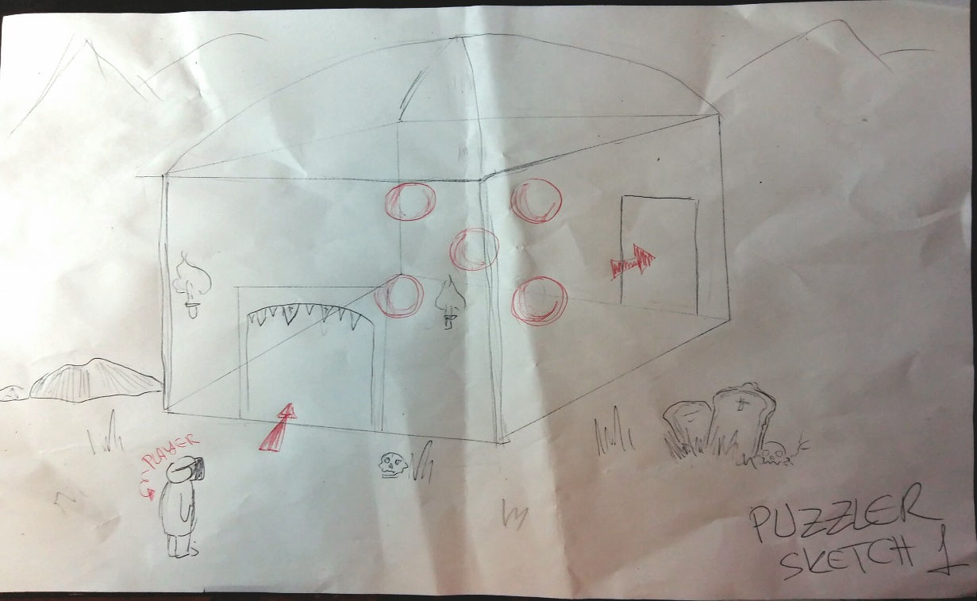
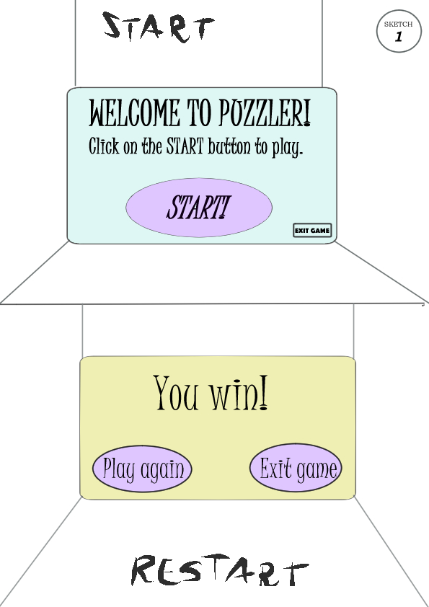
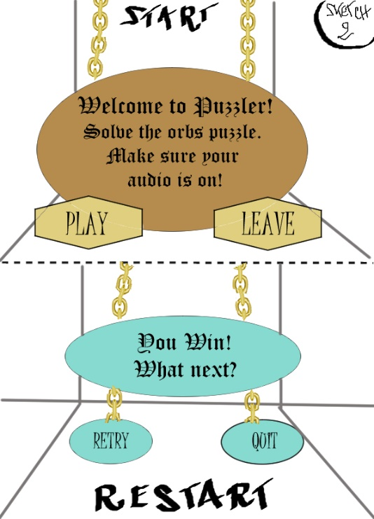

Slide 7
USER TESTING
Several tests were conducted on the game before declaring a “beta” version. Users came from different backgrounds, from computer connoisseurs to people who barley played a videogame.
Their feedback has been extremely useful to improve the following key areas:
Overall game environment and atmosphere.
Clarity of instructions, game rules and user-friendliness of the UI.
Detection of any discomfort in the movement and general impression of the travel experience from a VR space to another.
Entertainment.
Here’s a short resume of the feedback I received. Thanks to this, I was able to tweak the game right from the early stages.
USER TEST 1 – ENVIROMENT
The questions I asked to my testers after the played the game in its early stages were about the mood, mainly.
How would you describe the atmosphere ?
Grim
Immersive
What did you like the most about the game?
The torches
Lighting
The medieval theme
What could be improved, in your opinion?
What about the objects’ dimensions? Are they human-size?
Did you have fun during the experience?
Empty
Closed
Medieval
Mysterious
Ghastly
The textures
The skulls
The fact that is VR
The dungeon
There’s no background
Fix the lag
The orbs don’t look 3D
Dungeon too empty.
No sounds.
Unreal sky.
yes
Yes, as I never tried VR glasses before.
It’s ok but improvements could be done.

Slide 8
USERT TEST 2 – UI
This feedback request was about the clarity of the istructions and the funcionality on the “Start” and “restart” UI panels.
Start panel- How big is the panel in front of you? Is it too close or too far?
Too big
Too close
Restart panel- How big is the panel in front of you? Is it too close or too far
Size is ok
Start Panel -What do you think it happens when you hit the buttons?
Restart Panel -What do you think it happens when you hit the buttons?
You will start the game.
There is no exit button.
Is too high
Will restar the game.
There is no exit button
USERT TEST 3 – MOVEMENT
This test was conducted to spot in advance any discomfort or motion sickness during the VR experience.
Did you feel the speed was too slow or too fast?
Too Fast
Did you experience any discomfort?
Yes, experienced some nausea at the end.
No
Have you felt uncomfortably close or far away from game objects?
No
It is ok, maybe it’s a Little too fast.

Slide 9
USERT TEST 4 – PLAYABILITY
This test was conducted at a later stage, when the main features of the game were built and functioning.
Was the game fun to play?
Yes. Rules are very easy.
Yes but it is weird not having a controller.
How would you judge the difficulty of the puzzle?
The orbs blinked too fast.
The game is fairly simple.
How was your general gaming experience?
I liked it but I need to get accustomed.
It is ok, but one of the gravestones makes a bit difficult difficult to hit the “Quit” button in the Restart panel.
I like that sound was added to the orbs. Now it is clearer when you hit or miss the combination.
I don’t like the 3D orbs are now eyeballs.
Thumbs up!
BREAKDOWN OF THE FINAL PIECE
After drafting the general idea of the dungeon, I started building the scenario in Unity while collecting the feedback from testers every time I completed an essential design of the game. Before proceeding with further additions, I fixed the bugs and finally moved to refine the game and increase details.
Finally, I added sound effects to make the experience more realistic and user-friendly: adding sound to the eyeballs was important for a smoother gameplay because gave hints to the users about their correct selection (or not).
First of all, I wanted to solve the sensation of having a building floating into empty space, so I added some landscape mountains and closed the play area with a fence.
I wanted the player to be able to focus on the details of the surroundings but without having the sensation of being on a flat plane flying in a vacuum.

Slide 10
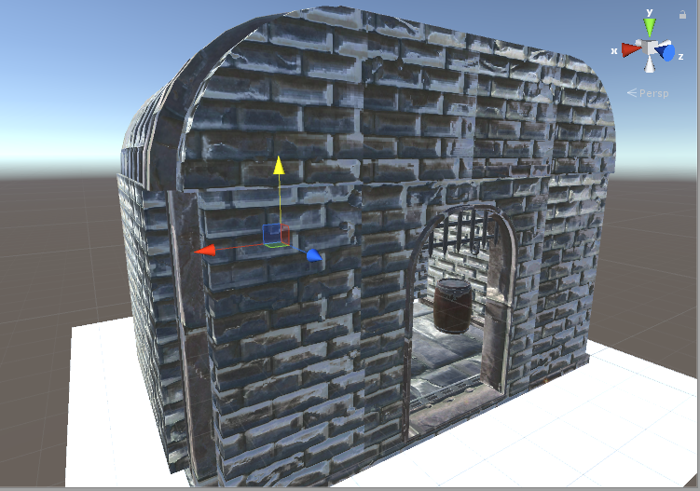
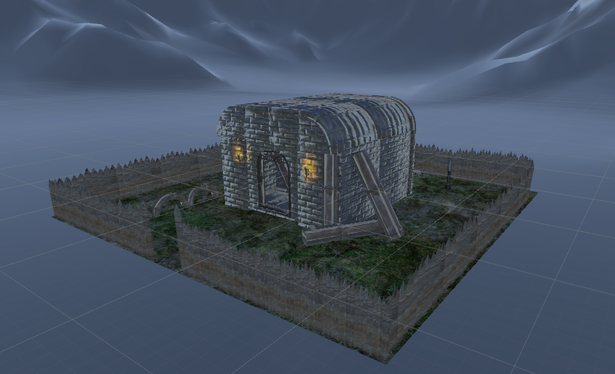
BEFORE AFTER
Secondly, I changed the appearance and disposition of the orbs.
I wanted to find something more in line with the “scary-but not-too-much” mood I wanted to achieve, so I changed the original blue spheres to eyeballs.
Also, I added a slight rotation on the X and Y axes, to make them more “alive”.
Finally, the original placement of the blue orbs was too random and I experienced motion sickness too, while testing the mechanics. Therefore, I reduced the speed of the “Simon Says” combinations and redistribute the orbs so that the player was not forced to turn his/her head around too much.

Slide 11
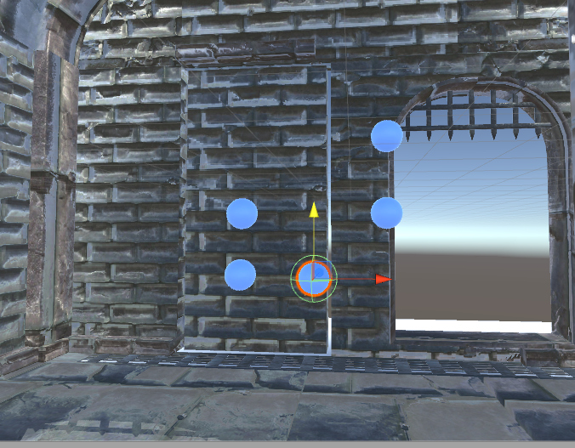
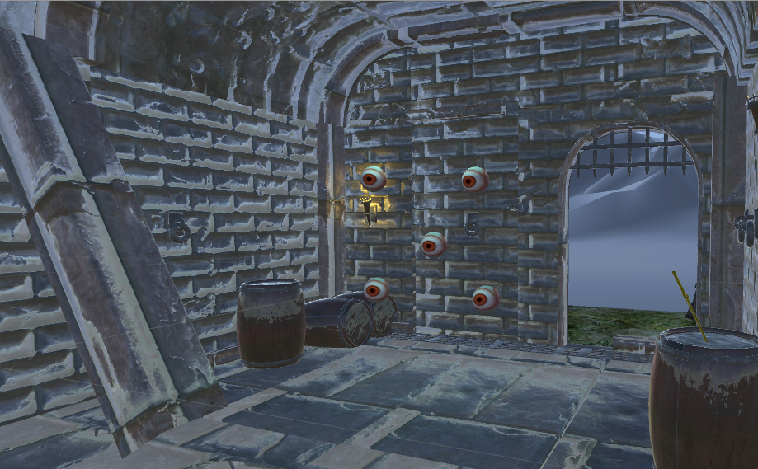
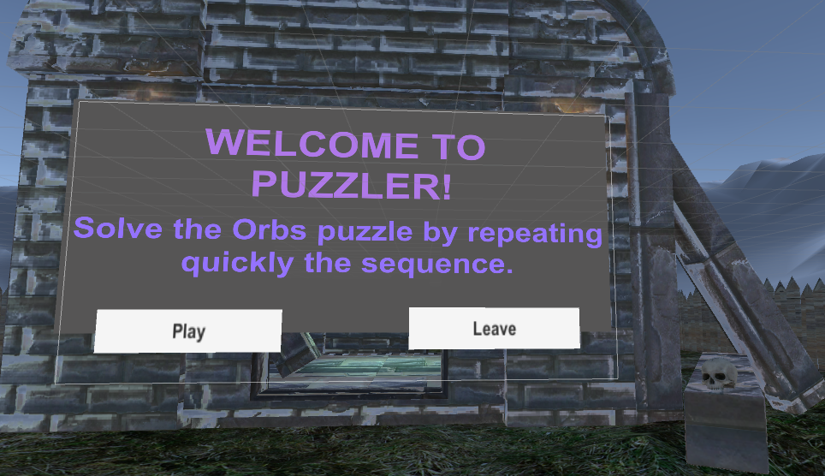
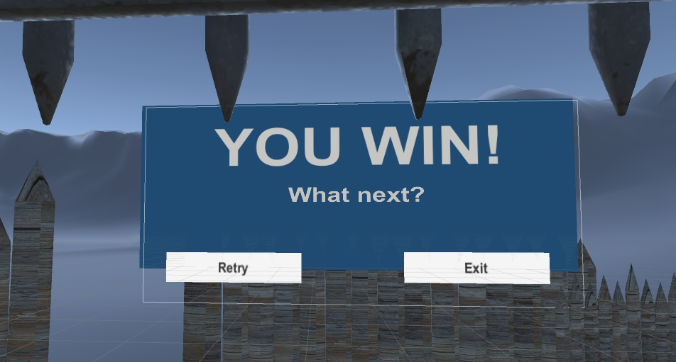
BEFORE AFTER
Last but not least, I added exit buttons to both Start and Restart UI panels, as the end user should be able to exit the game anytime.
At the beginning I used an adorned, medieval-style font, but I realized it was hardly readable with the VR glasses on. The final version below uses a simple but clearer font.

Slide 12
CONCLUSIONS
Puzzler has been a very entertaining project to work on. It was helpful for me as student as I learned how to build a simple game for virtual reality on mobile phones. I am eager to improve to make bigger, more detailed apps and games in the future.
Also the people I asked to test the game and provide some feedback had lots of fun in trying this new media.
As I am used to 3D models on powerful computers, it was a great change to develop for a platform as Android. I had to take into account many things I took for granted, like real time VS baked shadows and the importance of sound and light in a scene.
Also, I am not a programmer, so the biggest challenge was to start writing some code, learning the basics (yes, still doing it!) of C# and scout Unity and Udacity forums to understand my mistakes and improve.
Finally, switching to mobile VR presents challenges you don’t face when you play with a standard console or a phone app: the motion sickness, the lack of a gamepad or joystick, the speed and the movement, how to draw the attention of the player, who may be looking in a wrong direction, just to list a few.
It was very interesting to learn about the common practices that apply to Virtual reality, but at the same time it is very exciting to think that so much is still being tested.
VR is a powerful media but people and companies are still figuring out the best ways to exploit its infinite possibilities and applications.

